Slide 1



MediaScope: Selective On-Demand Media Retrieval from Mobile Devices
Yurong Jiang, Xing Xu, Peter Terlecky,
Tarek Abdelzaher, Amotz Bar-Noy, Ramesh Govindan
IPSN
2013

Slide 2
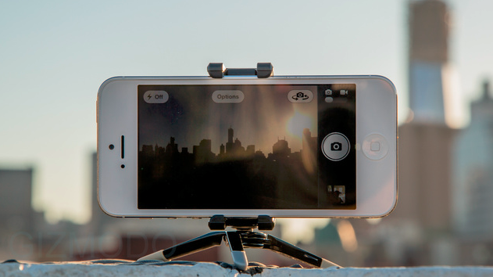





Availability Gap
Trends in Photo and Video Uploads – More & More Delayed
increasing bandwidth requirements
high-resolution cameras
restricted usage limits for cellular data plan
restricted cellular capacity
Delayed Uploads Resulting in – Availability Gap
Motivation
Problem
Conclusion
Evaluation
Design

Slide 3


Availability Gap in
Study of Uploads
40 users
50 images/user
50% Images are Uploaded 10+ Days Later! – Not Recent!
Motivation
Problem
Conclusion
Evaluation
Design

Slide 4
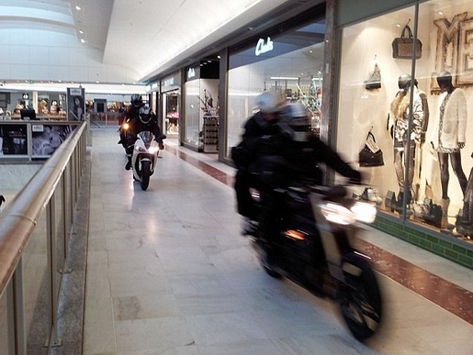
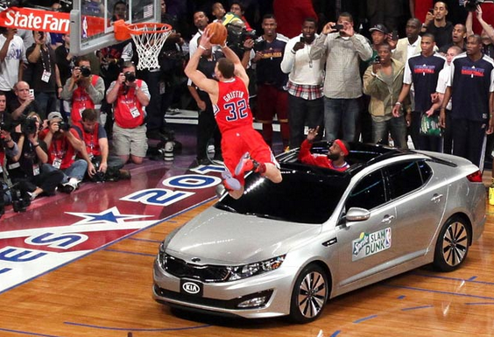
Bridge the Availability Gap ?
Mall Robbery
Sporting Event
Motivation
Problem
Conclusion
Evaluation
Design

Slide 5



Bridge the Availability Gap
Distributed Image Database: Most Recent, Most Diverse
Motivation
Problem
Conclusion
Evaluation
Design

Slide 6


MediaScope: Timely On-Demand Media Retrieval
On-Demand Retrieval Bridges the Availability Gap
Images from today’s game…
Timely Retrieval Can be Important for Many Apps
Respond in 30 seconds…
Motivation
Design
Evaluation
Conclusion
Problem

Slide 7




MediaScope Approach
NBA
USA
Motivation
Design
Evaluation
Conclusion
Problem

Slide 8
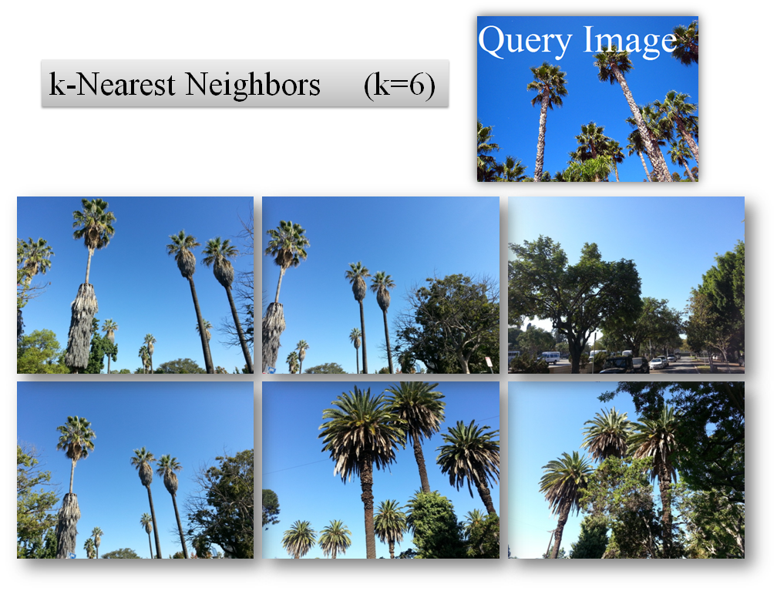
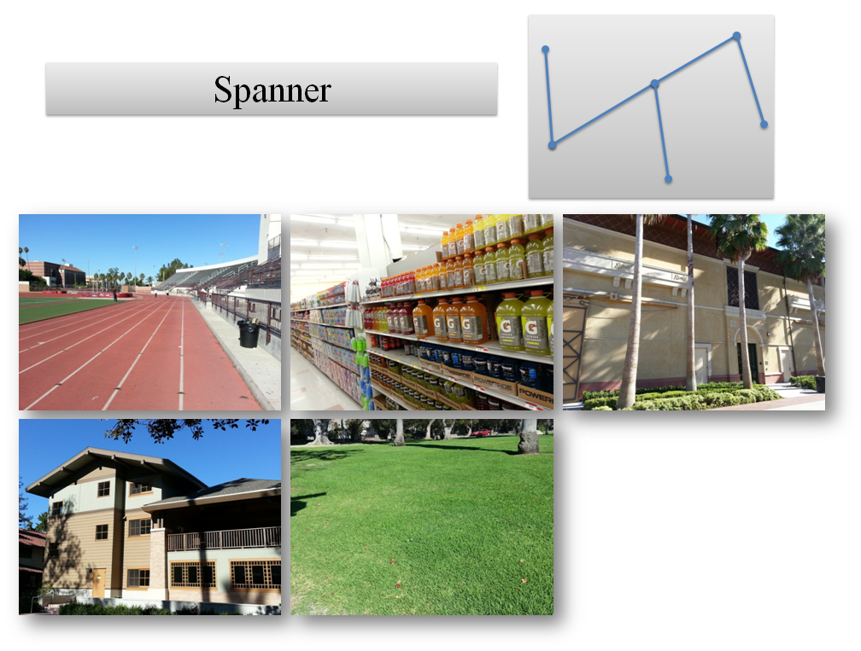
MediaScope Queries – for Different Needs
Top-K
Find K most Similar Images to Target Image
Spanner
Find a Collection of most Dissimilar Images
Motivation
Design
Evaluation
Conclusion
Problem

Slide 9
Challenges and Contributions
Selecting Relevant Query Results
Challenge: image search computationally-expensive
Contribution: adapt & generalize image-search technique
Return Results in a Timely Manner
Challenge: variable and limited wireless bandwidth
Contribution: optimize information-content uploaded
Mediascope – Timely On-Demand Image Retrieval
Motivation
Design
Evaluation
Conclusion
Problem

Slide 10



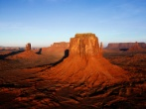



Image Search – on Image Feature Space
Location & Time – Filtering Out Irrelevant Media Files
Feature Vectors for Images – Support Geometric Queries
Img1 = { Loc = {Beijing, China},
Time = 2012-0716T19:20:30},
Visual Feature = {0, 3, 2, 5, … }}
Img2 = { Loc = {L.A., USA},
Time = 2013-0316T10:00:00},
Visual Feature = {1, 2, 0, 4, … }}
Img3 = { Loc = {Philly, USA},
Time = 2013-0408T09:00:00},
Visual Feature = {0, 7, 0, 3, … }}
Motivation
Problem
Evaluation
Conclusion
Design

Slide 11
Similarity on Feature Vectors
Visual Feature = {0, 3, 2, 5, 6, … }
statistical summary
Similarity Metric: Sim(x1, x2)
n coefficients feature vector
a point in n-dimensional space
Sim(x1, x2) ~ Distance(x1, x2)
color histogram
Motivation
Problem
Evaluation
Conclusion
Design

Slide 12



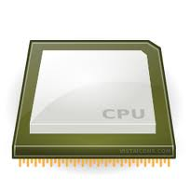

MediaScope System Overview
MSCloud
MSCloudDB
MSCloudQ
Medusa
MSMobile
Feature
Extractor
Object
Uploader
Motivation
Problem
Evaluation
Conclusion
Design

Slide 13
MSMobile - Feature Extractor
CEDD – Color & Edge Directivity Descriptor
144 coefficients ranging from [0..7]
54 bytes / image
Image Resizing before Feature Extraction
short feature-extraction time
acceptable error rate
1.5s proc. time
4% error rate
Error Rate (%)
Motivation
Problem
Evaluation
Conclusion
Design
Notes:
Smaller in size, easy to calculate

Slide 14
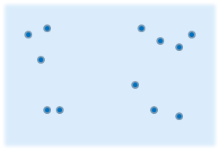
Geometric Queries in MediaScope
Top-K | Spanner | Cluster Representative
max(Sim(x, query)) | min(max(Sim(x1, x2)) | Clustering→ max(Sim(x, center))
O(V logV) | O(V²) | O(IV)
Similar x1, x2 → Greater Sim(x1, x2) Value
In Particular, Sim(x, x) = ∞
Motivation
Problem
Evaluation
Conclusion
Design

Slide 15

MSCloud – Timely Retrieval for Concurrent Queries
P1
Q1
Q1
Q1
Q1
Q2
Q2
Q2
Q2
P2
Q1
Q1
Q2
Q2
Q2
Q2
Trading off Query Completeness for Timeliness
maximize amount of retrieved information
credit-assignment mechanism
Motivation
Problem
Evaluation
Conclusion
Design

Slide 16




MSCloud – Queries & Credit Assignment
Each Query is Assigned Credits
divide up credits among selected images by importance
1000
800
100
100
Credit Assignment ~ Feature Space Geometry
Top-K
Spanner
credit ∝ similarity to target image
(credit)⁻¹ ∝ average similarity to other images
Motivation
Problem
Evaluation
Conclusion
Design

Slide 17
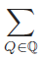
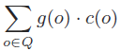
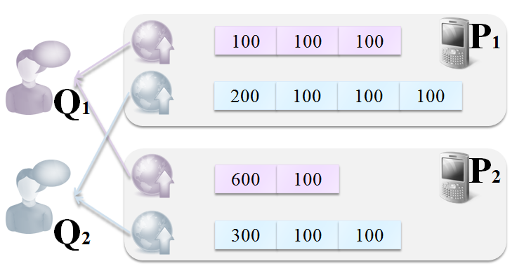



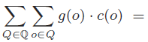
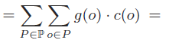
MSCloud – Credit Based Scheduling
Optimization Goal: Maximize Uploaded Credits
From Q1
From Q2
From P1
From P2
Motivation
Problem
Evaluation
Conclusion
Design

Slide 18

MSCloud – Credit Based Scheduling
P1
MSCloud
P1
Q1
Q1
Q1
Q1
P2
1. Filesize
2. Credit
3. Deadline
Q1
Q1
MSMobile
Motivation
Problem
Evaluation
Conclusion
Design

Slide 19
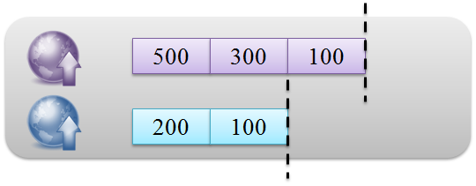



MSCloud – Credit Based Scheduling @ Phone
arrange images by deadlines
always give up smallest credit object
{(Filesize, Credit, Deadline)}
Optimal Scheduling for Same File Size (Same Uploading Time)
max(uploaded credits on-time)
Motivation
Problem
Evaluation
Conclusion
Design

Slide 20
MediaScope Evaluation
MSCloud
MSCloudQ (4300 LOC)
MSMobile
Java (1100 LOC)
PHP, Python
MSCloudDB
MySql
Prototype
Setup
MSMobile - 8 Android Phones
Metric
Query Trace Replay
Methodology
Evaluation
MSCloud - Dell XPS 7100
Query Completeness
Motivation
Problem
Design
Conclusion
Evaluation
Notes:
Deadline and credit

Slide 21
Query Completeness
MSC: MediaScope Credit-Based
MCF: Max Credit First
RR: Round Robin
EDF: Earliest Deadline First
OMNI: Omniscient
Motivation
Problem
Design
Conclusion
Evaluation
Notes:
Deadline and credit

Slide 22
MediaScope Overhead
Communication & system Overhead | Average Latency (ms)
C2DM Message | 150
Feature Vector Download | 138
Query Result Response | 54
Upload Scheduling | 46
Query Parsing | 24
Low Latency!
Component overhead | Energy (µAh)
Feature Extraction | 331
10% Battery Consumption ~ 400+ images
Motivation
Problem
Design
Conclusion
Evaluation

Slide 23
MediaScope Summary
MediaScope: Timely On-Demand Media Retrieval
supports geometric queries over feature space
timely returns informative retrieval results for queries
accurately & efficiently extracts visual features
Bridges Availability Gap
Motivation
Problem
Design
Evaluation
Conclusion

Slide 24
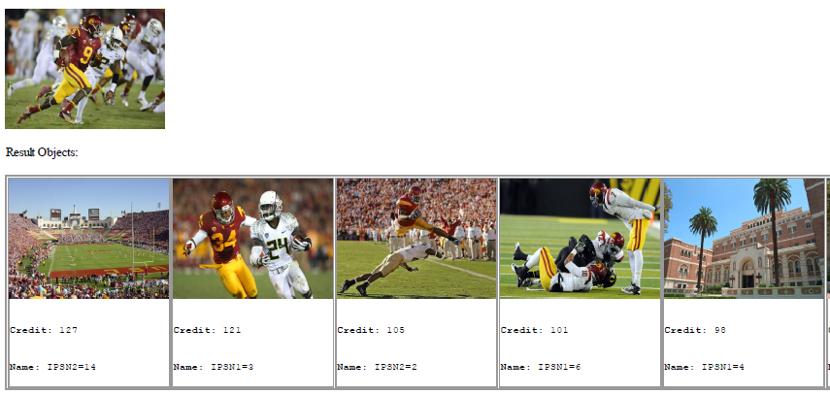
Query Sample

Slide 25
Query Completeness
Motivation
Problem
Design
Conclusion
Evaluation

Slide 26
MediaScope – Related Work
Content Based Image Retrieval
Faced Image Search, Virage Image Search Engine, ImgSeek
Search on Local Database vs. Mobile Setting
Image Search on Mobile Devices
CrowdSearch
Centralized Database vs. Distributed Database from Mobile Device
General Image Search Problem
Similarity Match (k-NN with k=1)
Geometric Search Queries on Feature Space
Motivation
Problem
Design
Evaluation
Conclusion

